Slide 1
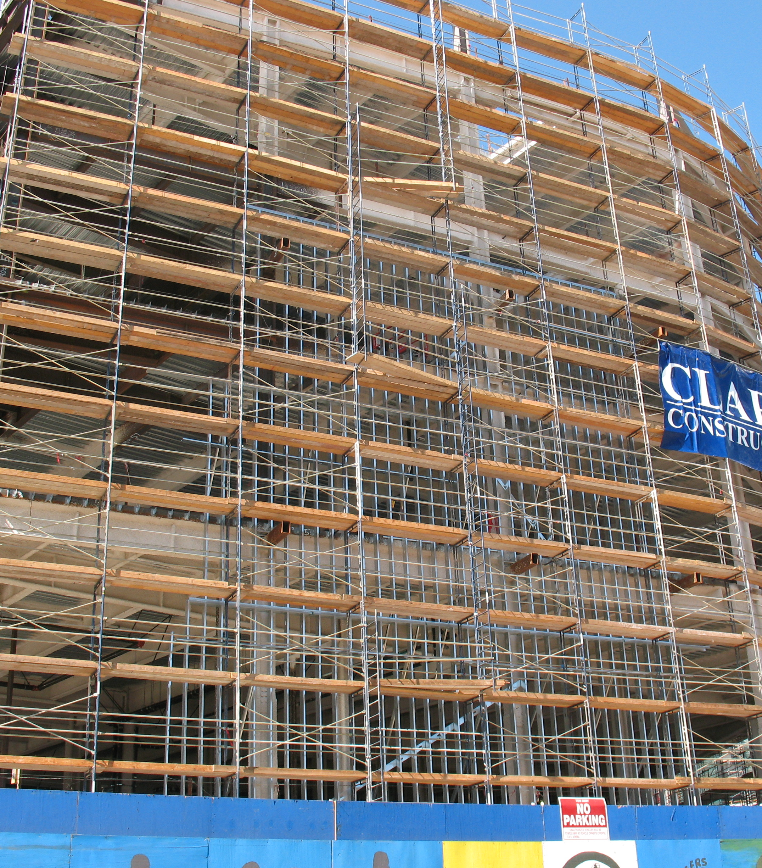
Construction Technology
By: Ethan Arocha, Ella Brown, Tyler Billingslea, Brooks Buffington

Slide 2
Solar Roadways
Pros and Cons
Pros: Its faster and more efficient
Cons: Very expensive

Slide 3
Virtual Reality
Pros and Cons
Pros: Its fun, entertaining and provides comfort for people
Cons: It can damage eyesight

Slide 4
Smart Highways
Pros and Cons
Pros: Better version of highways
Cons: Can shutdown highways during construction

