Slide 1
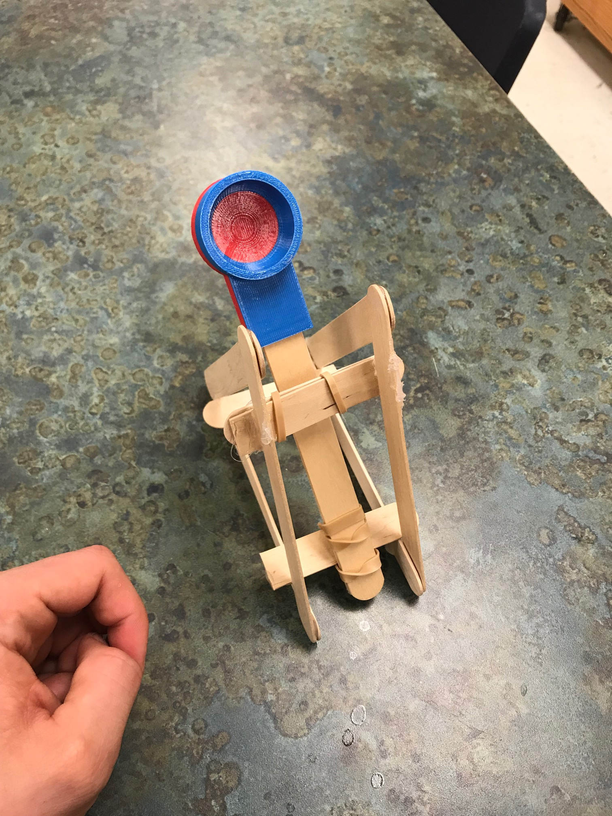
DIY Catapault
Tech Ed

Slide 2
Materials Needed
10 Popsicle sticks
Scissors
2 rubber bands
Hot glue (Provided)
3d Printed launcher (Provided)

Slide 3
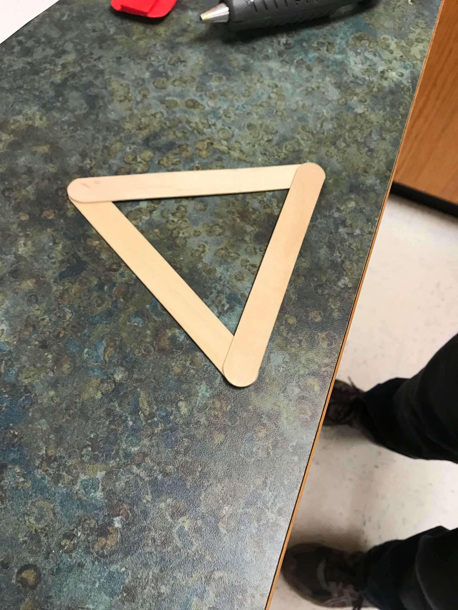
Take three popsicle sticks and hot glue them in a triangle shape

Slide 4
Repeat that process again

Slide 5
Using the template provided mark and cut two popsicle sticks in half
1
4
2
3

Slide 6
Glue two of the half sticks on the bottom connecting two triangles.
1
2

Slide 7
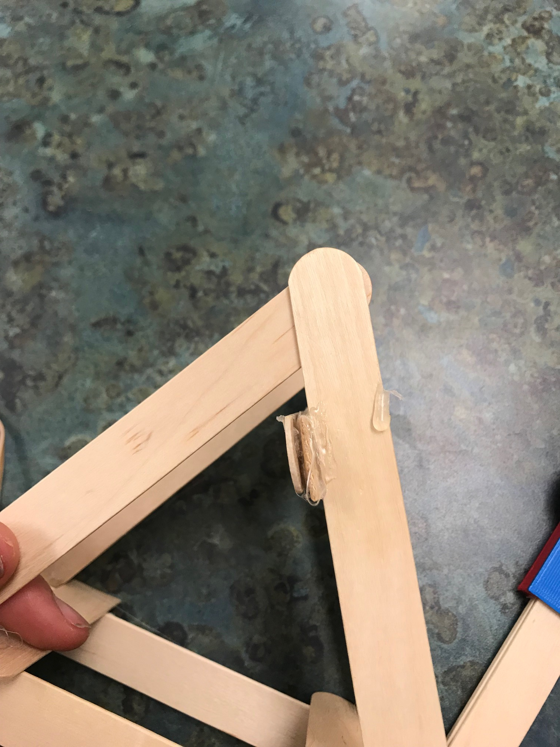
Glue other half popsicle sticks together and then glue to the back INSIDE of triangle
3
4

Slide 8
Catapault Frame is complete. Now we will make the arm and attach it

Slide 9
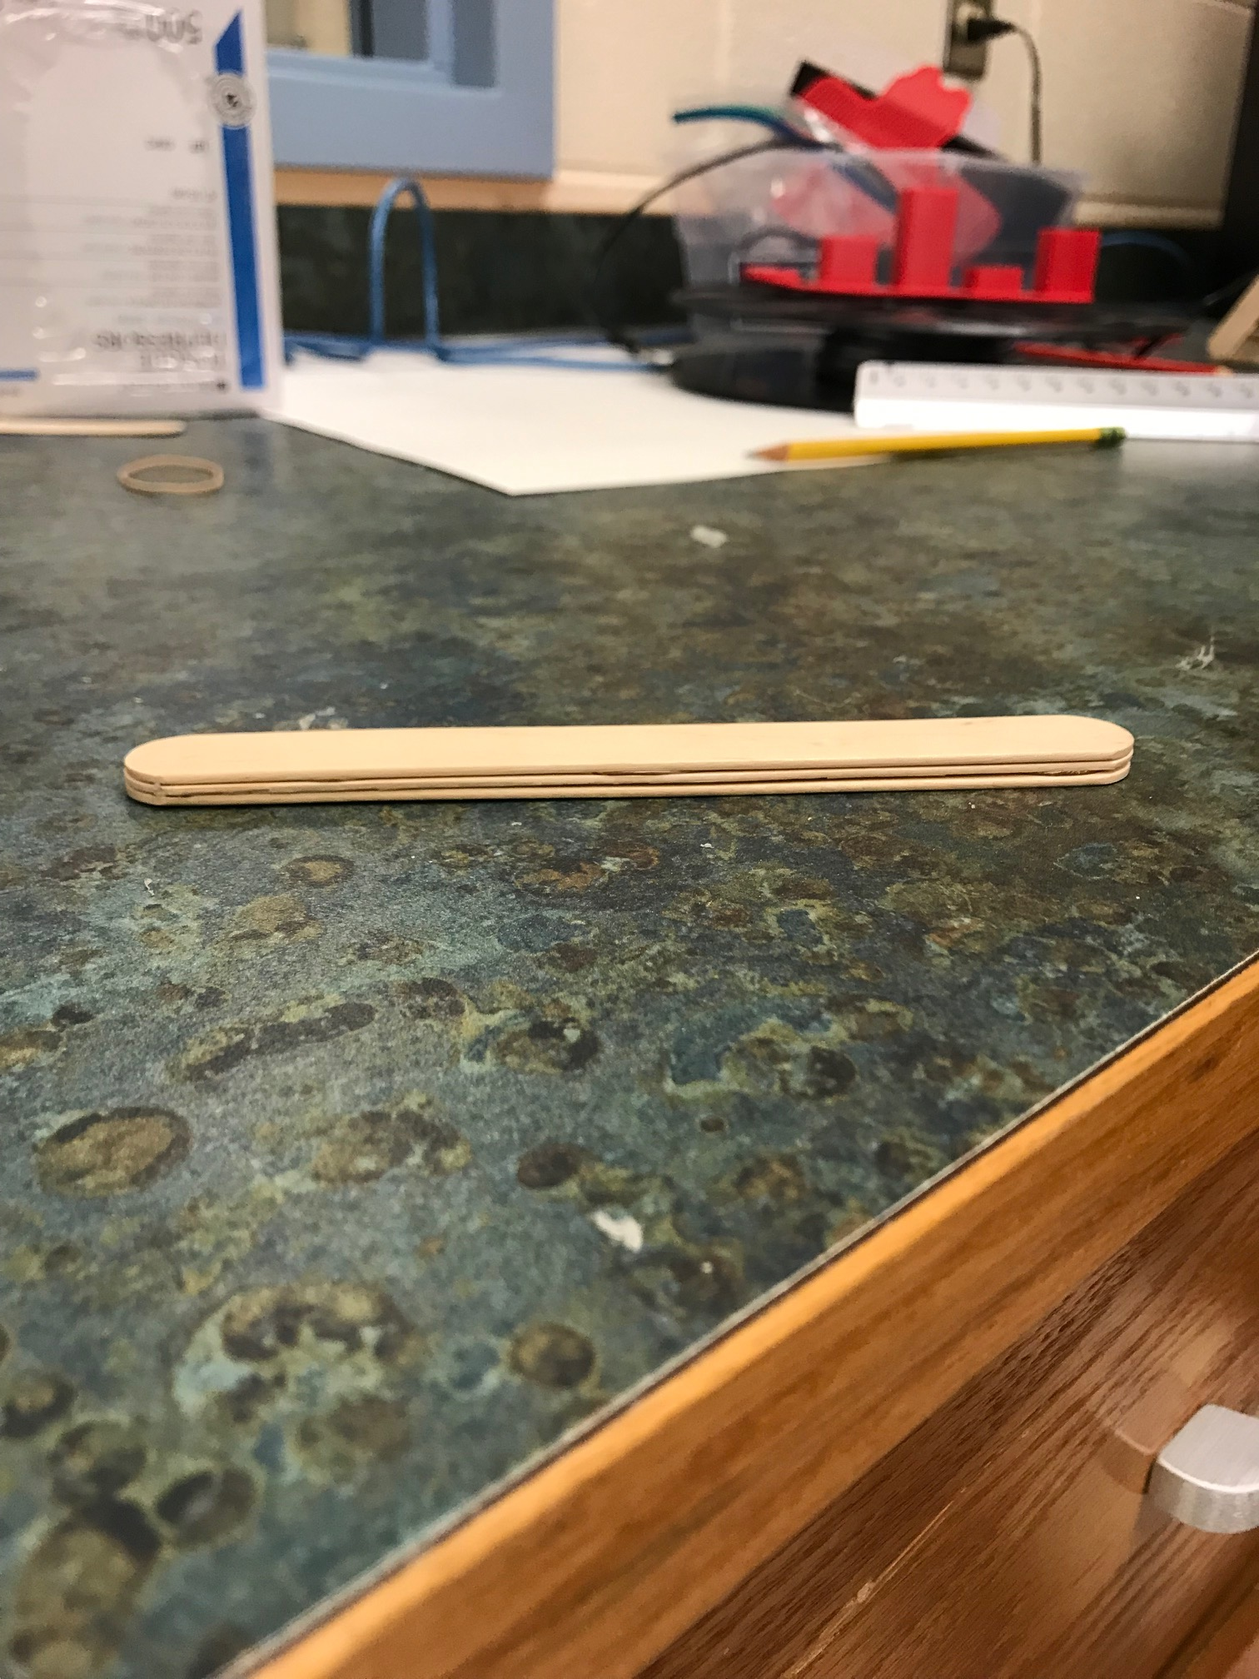
With your final 3 popsicle sticks glue them together into a stack

Slide 10
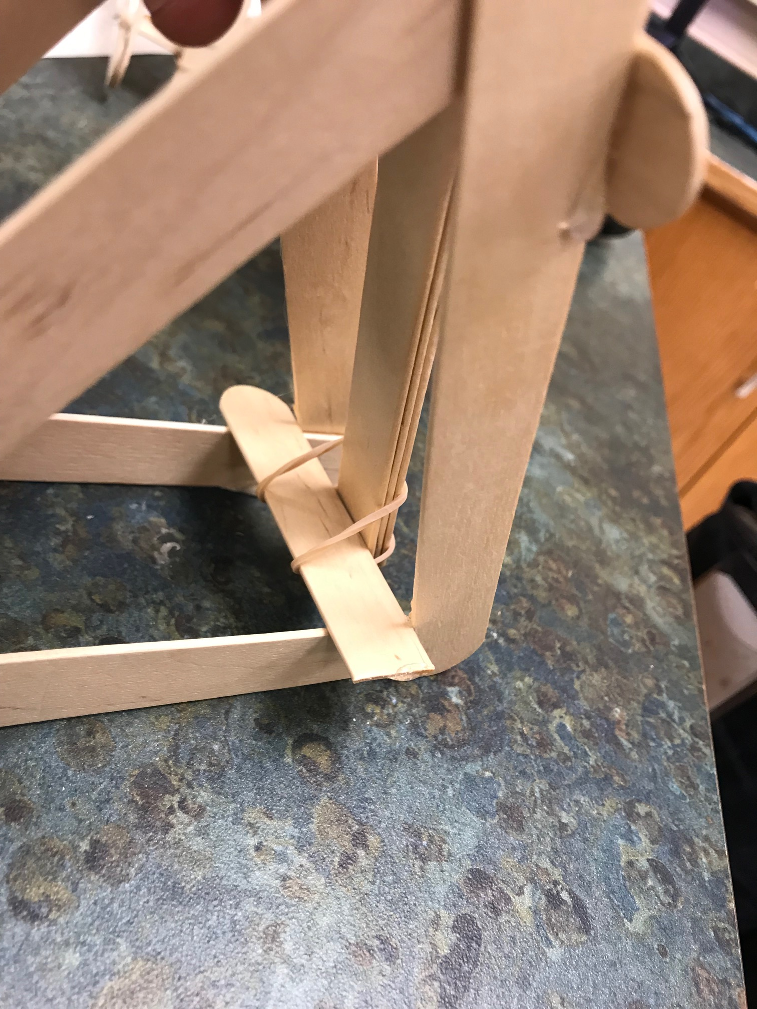
Use a rubber band and attach arm to the bottom of the base.
Make sure arm is behind the double sided popsicle stick

Slide 11
Use second rubber band to attach top of catapult

Slide 12
Place the 3d printed basket on arm

Slide 13
Your Catapault is ready to test. Make adjustments to improve performance!

